Slide 1

Architect an Azure Compute Infrastructure
ARM Virtual Machines
ARM Templates
Design for Availability
Containers

Slide 2
Exam 70-534 Architecting Microsoft Azure Solutions
#1 Design Azure Resource Manager (ARM) networking (5–10%)
Design Azure virtual networks - Extend on-premises
Describe Azure VPN and Express Route architecture and design
#2 Secure resources (20–25%)
Secure resources by using managed identities
Secure resources by using managed identities
Secure resources by using identity providers
Identify an appropriate data security solution
Design a role-based access control (RBAC) strategy
Manage security risks by using an appropriate security solution
#3 Design an application storage and data access strategy (5–10%)
Design data storage
Select the appropriate storage option
#4 Design advanced applications (20–25%)
Create compute-intensive applications
Create long-running applications
Integrate Azure services in a solution
Implement messaging applications
Implement applications for background processing
Design connectivity for hybrid applications
#5 Design Azure Web and Mobile Apps (5–10%)
Design Web Applications
Design Mobile Applications
#6 Design a management, monitoring, and business continuity strategy (20–25%)
Design a monitoring strategy
Describe Azure business continuity/disaster recovery (BC/DR) capabilities
Design a disaster recovery strategy
Design Azure Automation and PowerShell workflows
Describe the use cases for Azure Automation configuration
#7 Architect an Azure Compute infrastructure (10–15%)
Design ARM Virtual Machines (VMs)
Design ARM template deployment
Design for availability
+ Bonus: Containers
https://www.microsoft.com/learning/en-us/exam-70-534.aspx

Slide 3
#7 Architect an Azure Compute infrastructure (10–15%)
Design ARM Virtual Machines (VMs)
Design VM deployments leveraging availability sets, fault domains, and update domains in Azure; select appropriate VM SKUs
Design ARM template deployment
Author ARM templates; deploy ARM templates via the portal, PowerShell, and CL
Design for availability
Implement regional availability and high availability for Azure deployments

Slide 4
Architect an Azure Compute Infrastructure
Design ARM Virtual Machines
VM SKUs
Availability Sets
ARM Template Deployment
Author ARM Templates
Deploy ARM Templates
Portal
Powershell
CLI
Design for Availability
Regional Availability
High Availability
Containers
* Items in Bold Red are key points

Slide 5
VMs

Slide 6
VMs
When you pay for a VM, this is what you are paying for: Cores, RAM, Temp Disk
What is a VM?
Cores (CPUs)
RAM
Temp Disk
Disks
Network Interface Cards
Pricing is charged by the hour.
Partial hours are charged by the minute.
Storage is priced and charged separately.
VM Prices:
https://azure.microsoft.com/en-us/pricing/details/virtual-machines/linux/
Limits
20 VMs per region by default. (ASM LIMIT)
20 cores per region. 10,000 Max.
Limits: https://docs.microsoft.com/en-us/azure/azure-subscription-service-limits#virtual-machines-limits
What is the workload?
Require VMs or use PaaS
Windows/Linux
Containers
Encryption
Memory, CPU, Disk, Network intensive?
How many cores
How much disk space
SSDs required
IOPS required
How many NICs
Networking Speed
Scale
Up/Down
In/Out

Slide 7
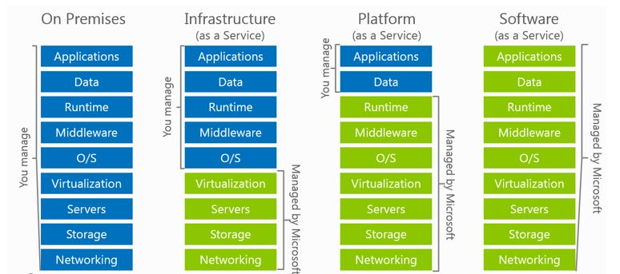
VMs or Paas?
Use VMs
Lift & Shift
Existing Deployment Model
OS customization required
Installed Dependencies required
Hardcoded lookups (Folders, drive letters, etc)
State-ful
Portability

Slide 8
VMs – Supported Operating Systems
Linux
CentOS
CoreOS
Debian
Oracle
Red Hat
SUSE
openSUSE
Ubuntu
Windows Server
Windows 2003* https://support.microsoft.com/en-us/help/3206074
Windows 2008R2+
https://docs.microsoft.com/en-us/azure/virtual-machines/linux/endorsed-distros
Distribution | Version | Drivers | Agent
CentOS | CentOS 6.3+, 7.0+ | CentOS 6.3: LIS download CentOS 6.4+: In kernel | Package: In repo under "WALinuxAgent" Source code: GitHub
CoreOS | 494.4.0+ | In kernel | Source code: GitHub
Debian | Debian 7.9+, 8.2+ | In kernel | Package: In repo under "waagent" Source code: GitHub
Oracle Linux | 6.4+, 7.0+ | In kernel | Package: In repo under "WALinuxAgent" Source code: GitHub
Red Hat Enterprise Linux | RHEL 6.7+, 7.1+ | In kernel | Package: In repo under "WALinuxAgent" Source code: GitHub
SUSE Linux Enterprise | SLES/SLES for SAP 11 SP4 12 SP1+ | In kernel | Package: for 11 in Cloud:Tools repo for 12 included in "Public Cloud" Module under "python-azure-agent" Source code: GitHub
openSUSE | openSUSE Leap 42.1+ | In kernel | Package: In Cloud:Tools repo under "python-azure-agent" Source code: GitHub
Ubuntu | Ubuntu 12.04, 14.04, 16.04, 16.10 | In kernel | Package: In repo under "walinuxagent" Source code: GitHub

Slide 9
VM Sizes
Determine Cores, RAM, ACUs, Disks, NICs, Network Speed, Temporary Storage, SSD support
High level categories:
Type | Sizes | Description
General purpose | DSv2, Dv2, DS, D, Av2, A0-7 | Balanced CPU-to-memory ratio. Ideal for testing and development, small to medium databases, and low to medium traffic web servers.
Compute optimized | Fs, F | High CPU-to-memory ratio. Good for medium traffic web servers, network appliances, batch processes, and application servers.
Memory optimized | GS, G, DSv2, DS | High memory-to-core ratio. Great for relational database servers, medium to large caches, and in-memory analytics.
Storage optimized | Ls | High disk throughput and IO. Ideal for Big Data, SQL, and NoSQL databases.
GPU | NV, NC | Specialized virtual machines targeted for heavy graphic rendering and video editing. Available with single or multiple GPUs.
High performance compute | H, A8-11 | Our fastest and most powerful CPU virtual machines with optional high-throughput network interfaces (RDMA).
https://docs.microsoft.com/en-us/azure/virtual-machines/virtual-machines-windows-sizes

Slide 10
VM Sizes – General Purpose
Dv2 Series
Size | CPU cores | Memory: GiB | Local SSD: GiB | Max local disk throughput: IOPS / Read MBps / Write MBps | Max data disks / throughput: IOPS | Max NICs / Network bandwidth
Standard_D1_v2 | 1 | 3.5 | 50 | 3000 / 46 / 23 | 2 / 2x500 | 2 / moderate
Standard_D2_v2 | 2 | 7 | 100 | 6000 / 93 / 46 | 4 / 4x500 | 2 / high
Standard_D3_v2 | 4 | 14 | 200 | 12000 / 187 / 93 | 8 / 8x500 | 4 / high
Standard_D4_v2 | 8 | 28 | 400 | 24000 / 375 / 187 | 16 / 16x500 | 8 / high
Standard_D5_v2 | 16 | 56 | 800 | 48000 / 750 / 375 | 32 / 32x500 | 8 / extremely high
https://docs.microsoft.com/en-us/azure/virtual-machines/windows/sizes-general

Slide 11
VM Disks
OS Disk (attached via SATA)
VHD based
Persists
Separate storage cost
Data Disk (SCSI)
VHD based
Persists
Separate storage cost
Temporary Disk
Doesn’t persist
No Separate storage cost
Current Max Disk Size: 1024GB
Premium Storage Disk Types
P10, P20, P30
Support for SSD (Premium Storage)
DS-series, DSv2-series, GS-series, and Fs-series.
You can use Standard OR Premium storage with these series.
Premium storage disk type | P10 | P20 | P30
Disk size | 128 GB | 512 GB | 1,024 GB (1 TB)
IOPS per disk | 500 | 2,300 | 5,000
Throughput per disk | 100 MB/s | 150 MB/s | 200 MB/s
https://docs.microsoft.com/en-us/azure/storage/storage-premium-storage#scalability-and-performance-targets
Notes:
Just like any other computer, virtual machines in Azure use disks as a place to store an operating system, applications, and data. All Azure virtual machines have at least two disks – a Windows operating system disk and a temporary disk. The operating system disk is created from an image, and both the operating system disk and the image are virtual hard disks (VHDs) stored in an Azure storage account. Virtual machines also can have one or more data disks, that are also stored as VHDs.

Slide 12
Increase size of existing Disks
You can easily increase the size of existing disks. For example, you might want to increase the size of a 30-GB disk to 128 GB, or even to 1 TB. Or, you might want to convert your P20 disk to a P30 disk because you need more capacity or more IOPS and throughput.
https://docs.microsoft.com/en-us/azure/storage/storage-premium-storage#scalability-and-performance-targets

Slide 13
VM Disks
Unmanaged Disks – Requires Azure Storage Container https://docs.microsoft.com/en-us/azure/storage/storage-scalability-targets#unmanaged-virtual-machine-disks
Disks are stored in Page Blob VHD files.
VM disks in an availability set should be in separate storage accounts.
Standard Storage
No performance SLAs
Charged for disk usage, not the size. (If you have provisioned a 100GB disk and are only using 20GB, you pay for 20GB).
Max IOPS per storage account: 20,000 (e.g. 40 disks @ 500 IOPS each)
Premium Storage
Yes performance SLAs
Disk Capacity is 35TB
50 GiB/s for inbound/outbound
Billed for the provisioned amount at the closest tier, rounded up. 100GB disk is charged a P10 rate (128GB), even if it is completely empty.
Managed Disks – Azure manages the disks for you. https://docs.microsoft.com/en-us/azure/storage/storage-managed-disks-overview
No storage account required.
Disks can be exported to Snapshots and downloaded as VHD files.
Isolates disks for VMs in an availability set for increased resiliency.
Standard and Premium as well

Slide 14
VM Disks
Disks can be resized up to 1TB
Disks can be striped to achieve greater IOPS/Storage Size.
VMs can achieve 80,000 IOPS with disk throughput of 2MB/s.
Disk and Azure Storage pricing: https://azure.microsoft.com/en-us/pricing/details/storage/blobs/
Encryption:
IaaS VMs are secured at rest, because you can use industry-standard encryption technology to address organizational security and compliance requirements.
IaaS VMs boot under customer-controlled keys and policies, and you can audit their usage in your key vault.
https://docs.microsoft.com/en-us/azure/security/azure-security-disk-encryption#disk-encryption-deployment-scenarios-and-user-experiences
Disk Caching
None – for Write only and Write heavy (SQL Logs)
ReadOnly – for Read only or read-write disks (SQL Data files)
ReadWrite – for Operating System disks
https://docs.microsoft.com/en-us/azure/storage/storage-premium-storage

Slide 15
VM Azure Compute Unit (ACU)
SKU Family | ACU/Core
A0 | 50
A1-A4 | 100
A5-A7 | 100
A1_v2-A8_v2 | 100
A2m_v2-A8m_v2 | 100
A8-A11 | 225*
D1-D14 | 160
D1_v2-D15_v2 | 210 - 250*
DS1-DS14 | 160
DS1_v2-DS15_v2 | 210-250*
F1-F16 | 210-250*
F1s-F16s | 210-250*
G1-G5 | 180 - 240*
GS1-GS5 | 180 - 240*
H | 290 - 300*
L4s-L32s | 180 - 240*
M | 160-180**
Not all Azure Cores are created equal
A1 Core != F1 Core
Compare compute (CPU) performance across SKUs.
https://docs.microsoft.com/en-us/azure/virtual-machines/windows/acu

Slide 16
VM Disks
Disk Snapshots let you capture current state copies of your disks.
Managed Disks: Take Snapshots of the disk https://docs.microsoft.com/en-us/azure/storage/storage-managed-disks-overview#images-versus-snapshots
Unmanaged Disks: Take Snapshots of the underlying VHD blob https://docs.microsoft.com/en-us/azure/storage/storage-incremental-snapshots
Images are representations of your VM that you can use to create more instances of the VM
You can capture an Image of a VM and it will include all the disks. https://docs.microsoft.com/en-us/azure/virtual-machines/windows/capture-image-resource
Snapshots only capture one disk at a time.

Slide 17
VM Scaling
Resize VMs (Scale up or down)
Offline operation
Just a reboot if in a cluster that supports new size
Requires a deallocation if new size is not supported in the cluster (a little longer)
If the VM is part of an availability set and the new size is not supported in the cluster, all VMs in the availability set will need to be deallocated for the resize to happen
https://docs.microsoft.com/en-us/azure/virtual-machines/windows/resize-vm
Scale In or Out
You can create new instances of the VM based on platform images (max 1000) or your own custom images (max 100)
Using VM Scale Sets https://docs.microsoft.com/en-us/azure/virtual-machine-scale-sets/virtual-machine-scale-sets-overview
Using Azure Automation
Scheduled
Azure Autoscale
System Metrics (CPU, RAM, etc)
Custom Metrics https://docs.microsoft.com/en-us/azure/monitoring-and-diagnostics/monitoring-overview-autoscale#resource-metrics

Slide 18
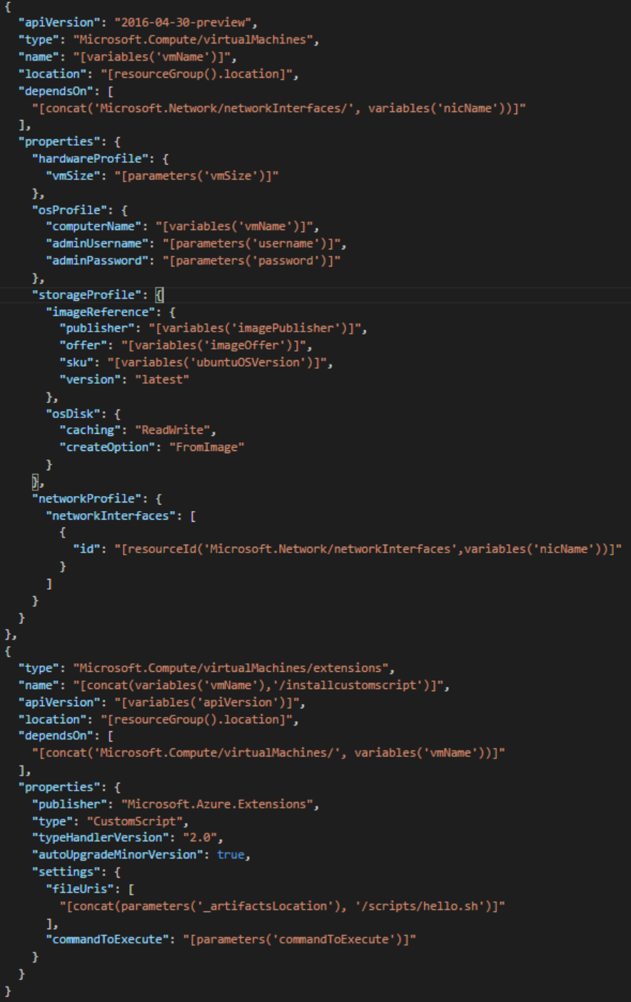
VM ARM Template Notes
osProfile (computerName, admin user/pass)
ComputerName != VM Name
Image Reference (Publisher, Offer, Sku, Version)
Custom Script Extensions
Execute bash (Linux) or Powershell (windows)
Script files must be externally available
Pass in first command to execute
Usually a call to a script file

Slide 19
VM Recommendations
Premium Storage for Production Workloads (Storage SLAs)
Choose a VM Size that works with premium storage for production
Use Managed Disks over Unmanaged Disks
Scaling Up/Down is just resizing the VM
Scaling In/Out – the VMs should be in an availability set
Use VM reboot logs to determine if VM was rebooted by planned maintenance
Use snapshots to prevent accidental data loss
Enable VM diagnostics for production (includes boot diagnostics)
Stopped VMs are still charged for use. VMs need to be deallocated to stop charges. Stopping through OS does not deallocate! Stop with portal or CLI.
Use OSPatching VM extension to patch your OS. You can specify how often and whether to reboot.
https://docs.microsoft.com/en-us/azure/architecture/reference-architectures/virtual-machines-linux/single-vm

Slide 20
Availability Sets

Slide 21
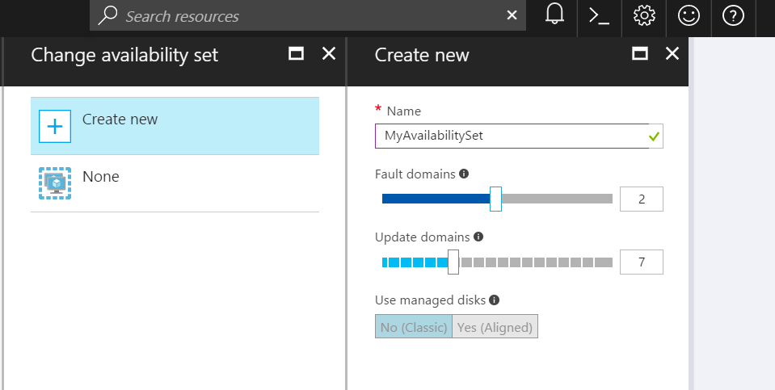
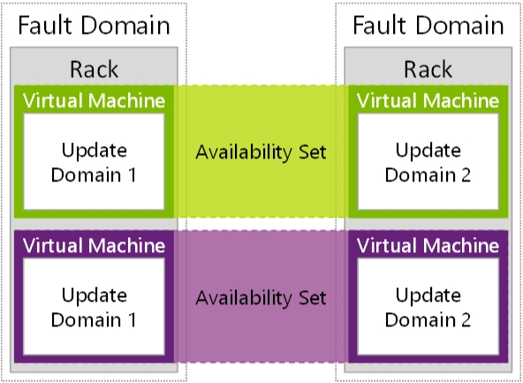
Availability Sets
Availability Sets are for Unplanned & Planned Maintenance
Fault Domains (2 default, some regions allow 3)
Upgrade Domains (5 default, 1-20 allowed)
Separate each app role/tier into separate Availiability Sets (2000 per region)
Front with Load Balancer, App Gateway
Do NOT put a single VM in an Availability Set
https://docs.microsoft.com/en-us/azure/virtual-machines/windows/manage-availability

Slide 22
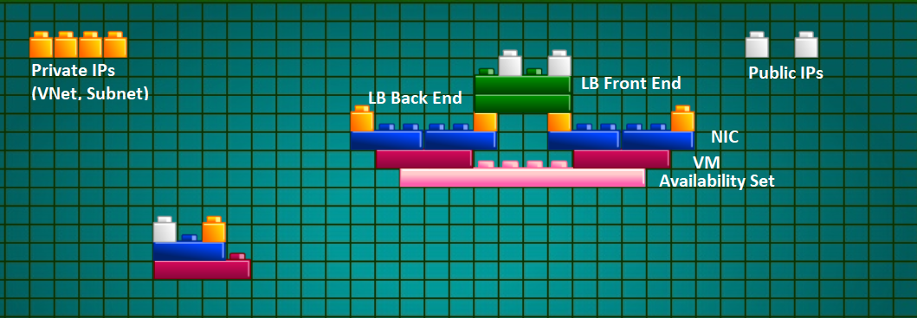
VM Networking Lego Blocks

Slide 23
ARM Templates

Slide 24
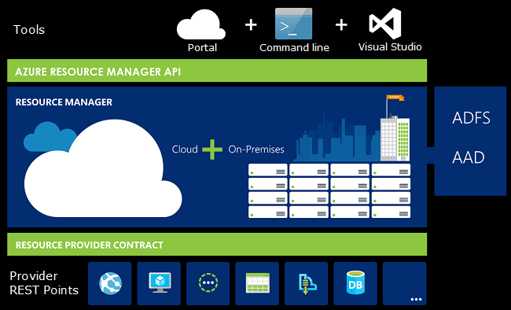
What is ARM?
Resource – Any Azure Service
Resource Group – A container for Azure Resources. Resources only belong to one group. You can grant permissions to users/groups on all resources in a group.
Resource Provider – Service that supplies the resources you can deploy.
Resource Manager Template – a JSON file that defines one more resources deployed to a group and relationships between them.

Slide 25
Author ARM Templates -
JSON Document
Structure
Functions
Nesting
Dependencies
Multiple Resources (Loops)
Advanced Topics

Slide 26
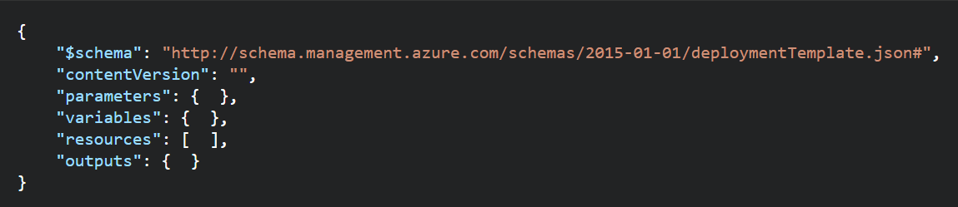
ARM Templates - Structure
Element name | Required | Description
$schema | Yes | Location of the JSON schema file that describes the version of the template language. Use the URL shown in the preceding example.
contentVersion | Yes | Version of the template (such as 1.0.0.0). You can provide any value for this element. When deploying resources using the template, this value can be used to make sure that the right template is being used.
parameters | No | Values that are provided when deployment is executed to customize resource deployment.
variables | No | Values that are used as JSON fragments in the template to simplify template language expressions.
resources | Yes | Resource types that are deployed or updated in a resource group.
outputs | No | Values that are returned after deployment.

Slide 27
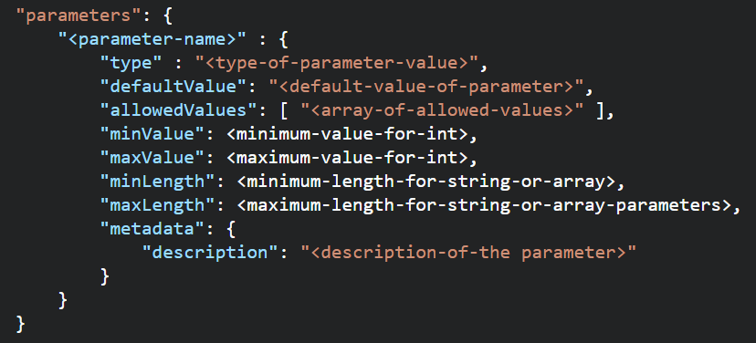
ARM Templates - Parameters
Element name | Required | Description
parameterName | Yes | Name of the parameter. Must be a valid JavaScript identifier.
type | Yes | Type of the parameter value. See the list of allowed types after this table.
defaultValue | No | Default value for the parameter, if no value is provided for the parameter.
allowedValues | No | Array of allowed values for the parameter to make sure that the right value is provided.
minValue | No | The minimum value for int type parameters, this value is inclusive.
maxValue | No | The maximum value for int type parameters, this value is inclusive.
minLength | No | The minimum length for string, secureString, and array type parameters, this value is inclusive.
maxLength | No | The maximum length for string, secureString, and array type parameters, this value is inclusive.
description | No | Description of the parameter that is displayed to users through the portal.
Allowed Types
string
secureString
int
bool
object
secureObject
array

Slide 28
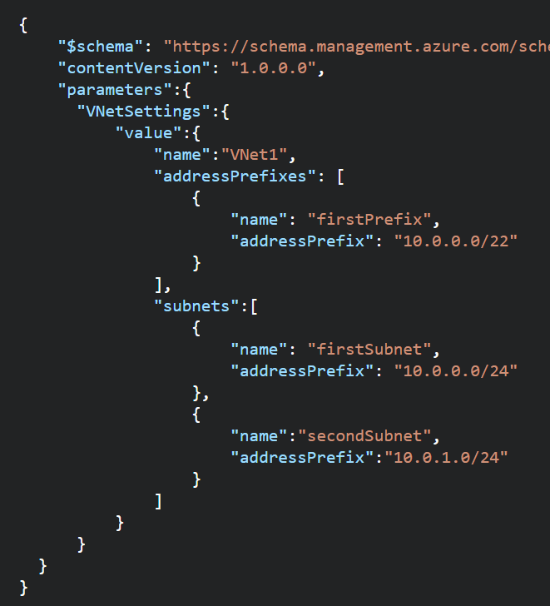
ARM Templates – Parameters
Use Parameters for
Template Reusability
Settings that you want to use variations of according to environment (SKU, size, capacity).
Resource names that you want to specify for easy identification.
Values that you use frequently to complete other tasks (such as an admin user name).
Secrets (such as passwords).
The number or array of values to use when you create multiple instances of a resource type.
Use SecureString type for Passwords
Use default values (except for passwords or secrets)
Only 255 parameters per Template
Parameters can also be passed as Objects
https://docs.microsoft.com/en-us/azure/azure-resource-manager/resource-manager-template-best-practices#parameters

Slide 29
Re-use ARM Templates
By passing in parameters to your ARM Templates, you can re-use them in many different scenarios. You can deploy full solutions with t-shirt sizing (Small, Medium, Large) based on parameters you pass in: Size of VM, # of VMs, etc.
Be aware of what values in the ARM template need to be unique when re-using templates: https://docs.microsoft.com/en-us/azure/azure-resource-manager/resource-manager-template-best-practices#resource-names
https://docs.microsoft.com/en-us/azure/azure-resource-manager/best-practices-resource-manager-design-templates

Slide 30
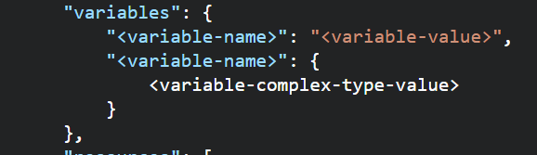
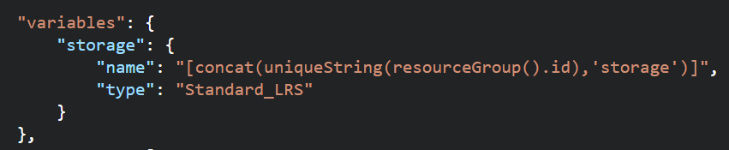
ARM Templates –Variables
Use Variables for
Use variables for values that you need to use more than once in a template.
Include variables for resource names that must be unique.
Use variables for extra manipulation of parameters
You can group variables into complex objects. Use the variable.subentry format to reference a value from a complex object.
https://docs.microsoft.com/en-us/azure/azure-resource-manager/resource-manager-template-best-practices#variables

Slide 31
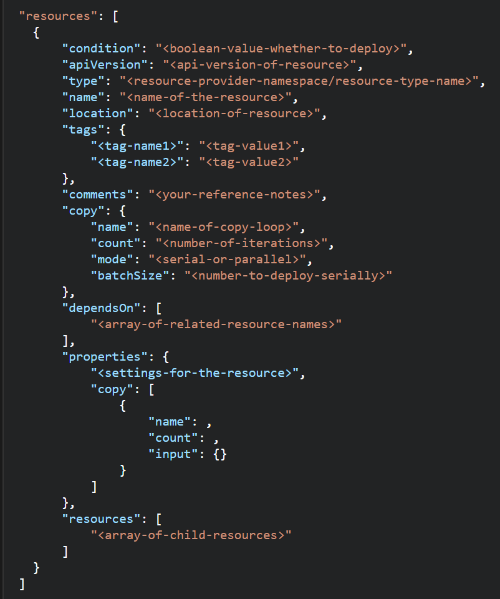
ARM Templates -Resources
When building resources:
This section can get complicated because every resource type has different properties
Use comments to describe what the resource is for.
Use tags for organizing resources
Don’t assign a public IP to a VM in the template if you don’t plan to access it directly. You can always create a public IP later if you need to login. Or, use a Load balancer NAT rule.
Some resource names must be GLOBALLY unique
You can use the uniqueString() function, a meaningful prefix, and other parameters to create names that are unique for the resource group or subscription. Globally unique is not guaranteed.
https://docs.microsoft.com/en-us/azure/azure-resource-manager/resource-manager-template-best-practices#resources

Slide 32
ARM Templates -Resources
Element name | Required | Description
condition | No | Boolean value that indicates whether the resource is deployed.
apiVersion | Yes | Version of the REST API to use for creating the resource.
type | Yes | Type of the resource. This value is a combination of the namespace of the resource provider and the resource type (such as Microsoft.Storage/storageAccounts).
name | Yes | Name of the resource. The name must follow URI component restrictions defined in RFC3986. In addition, Azure services that expose the resource name to outside parties validate the name to make sure it is not an attempt to spoof another identity.
location | Varies | Supported geo-locations of the provided resource. You can select any of the available locations, but typically it makes sense to pick one that is close to your users. Usually, it also makes sense to place resources that interact with each other in the same region. Most resource types require a location, but some types (such as a role assignment) do not require a location. See Set resource location in Azure Resource Manager templates.
tags | No | Tags that are associated with the resource. See Tag resources in Azure Resource Manager templates.
comments | No | Your notes for documenting the resources in your template
copy | No | If more than one instance is needed, the number of resources to create. The default mode is parallel. Specify serial mode when you do not want all or the resources to deploy at the same time. For more information, see Create multiple instances of resources in Azure Resource Manager.
dependsOn | No | Resources that must be deployed before this resource is deployed. Resource Manager evaluates the dependencies between resources and deploys them in the correct order. When resources are not dependent on each other, they are deployed in parallel. The value can be a comma-separated list of a resource names or resource unique identifiers. Only list resources that are deployed in this template. Resources that are not defined in this template must already exist. Avoid adding unnecessary dependencies as they can slow your deployment and create circular dependencies. For guidance on setting dependencies, see Defining dependencies in Azure Resource Manager templates.
properties | No | Resource-specific configuration settings. The values for the properties are the same as the values you provide in the request body for the REST API operation (PUT method) to create the resource. You can also specify a copy array to create multiple instances of a property. For more information, see Create multiple instances of resources in Azure Resource Manager.
resources | No | Child resources that depend on the resource being defined. Only provide resource types that are permitted by the schema of the parent resource. The fully qualified type of the child resource includes the parent resource type, such as Microsoft.Web/sites/extensions. Dependency on the parent resource is not implied. You must explicitly define that dependency.

Slide 33
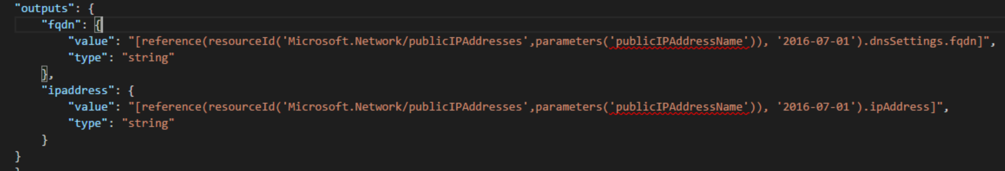
ARM Templates –Outputs
If you use a template to create public IP addresses, include an outputs section that returns details of the IP address and the fully qualified domain name (FQDN). You can use output values to easily retrieve details about public IP addresses and FQDNs after deployment. When you reference the resource, use the API version that you used to create it
Use Outputs to see other values that can’t be determined before the template is created (especially when Unique Ids are generated).
https://docs.microsoft.com/en-us/azure/azure-resource-manager/resource-manager-template-best-practices#outputs

Slide 34
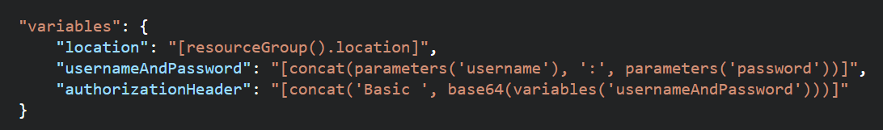
ARM Templates – Functions and Expressions
Templates are JSON
Functions and Expressions extend the JSON capabilities
They let you use some coding notions inside your templates to create or evaluate dynamic values
Functions you see often:
concat – concatenates multiple values
copyIndex – returns the index of an iteration loop
resourceGroup – access properties of this resource group, like the location.
resourceId – get the unique identifier for a resource.
All Functions: https://docs.microsoft.com/en-us/azure/azure-resource-manager/resource-group-template-functions

Slide 35
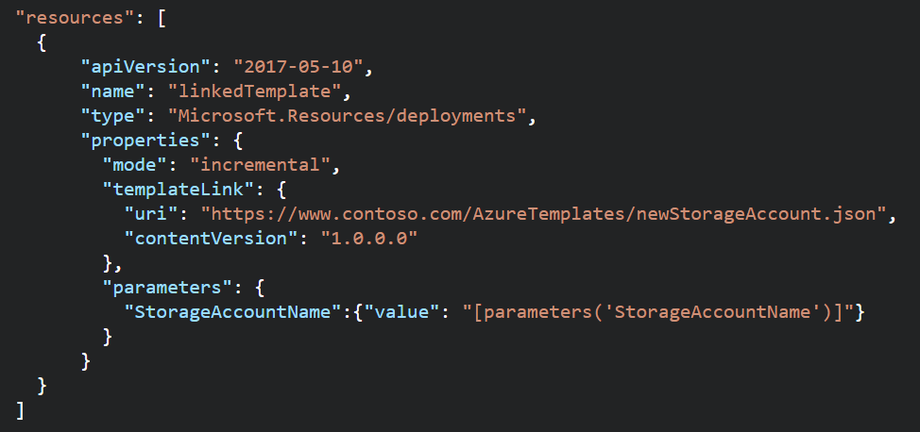

ARM Templates - Nesting
ARM Templates can call other ARM Templates
Create purpose-specific templates
Pass parameters into sub-templates
You can also pass in a parameter file link
Retrieve values out of templates with reference function and outputs
Sub template links must be externally available (but you can use an Azure storage account and SAS token to secure it)
You can provide a link to a template or define a sub template directly inside of a parent template.
Nested templates can be deployed to a different resource group
https://docs.microsoft.com/en-us/azure/azure-resource-manager/resource-group-linked-templates

Slide 36
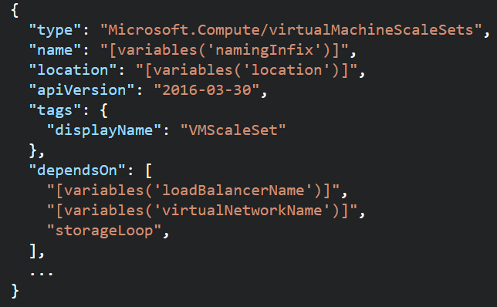
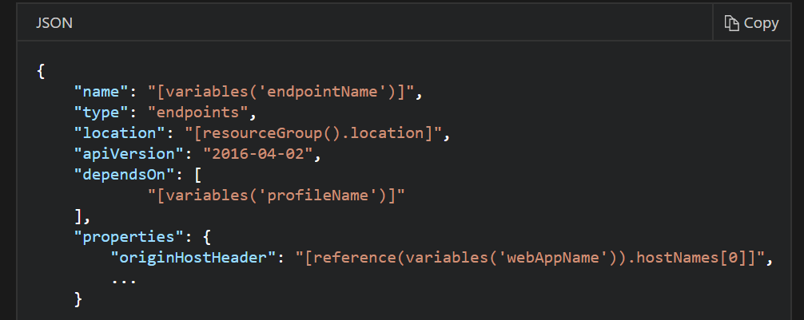
ARM Templates - Dependencies
Resources may require a dependency chain; e.g. You need a VNET before you can deploy a VM.
Use “dependsOn” property to explicitly build the dependencies between resources. Resources wont get created until their dependencies are created.
Use Child resources. Only certain resources can have child resources.
Use the “reference” function to create an implicit relationship. Resources that reference another resource are created after the referenced resource.
https://docs.microsoft.com/en-us/azure/azure-resource-manager/resource-group-define-dependencies

Slide 37
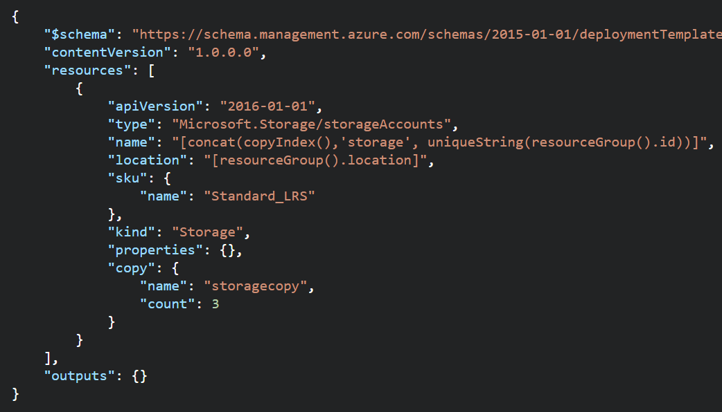
ARM Templates – Multiple Instances
You can create multiple instances in parallel of a resource.
Use the “copy” property to indicate the # of instances
Can be used with length() function on Array to iterate through the collection.
Use the “copyIndex()” function to get the current iteration.
Use it to name resources uniquely.
0 based, but can accept an offset (copyIndex(1))
To create multiple instances of a property (e.g. data disks for a VM), use “copy” property as an array with the name of the property you want multiple instances of (see docs)
You can create dependencies on the copy loops (e.g. Wait for 3 storage accounts to be created, then create a VM).
https://docs.microsoft.com/en-us/azure/azure-resource-manager/resource-group-create-multiple

Slide 38
ARM Templates Advanced Topics
Creating and Updating Resources in one ARM Template based deployment: https://docs.microsoft.com/en-us/azure/azure-resource-manager/resource-manager-update
Share state between linked templates: https://docs.microsoft.com/en-us/azure/azure-resource-manager/best-practices-resource-manager-state
Patterns for deploying resources: https://docs.microsoft.com/en-us/azure/azure-resource-manager/best-practices-resource-manager-design-templates

Slide 39
Deploy Templates

Slide 40
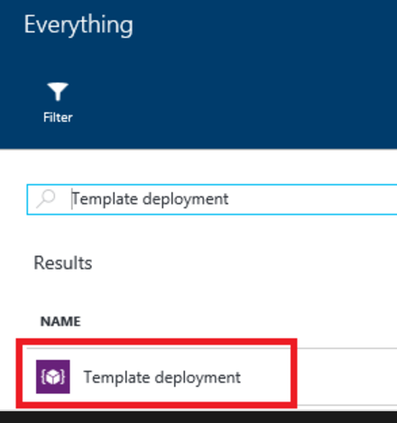
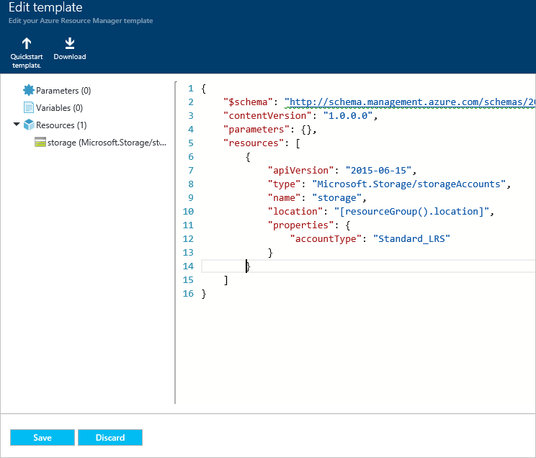
Deploy Templates – Portal, Custom Template

Slide 41
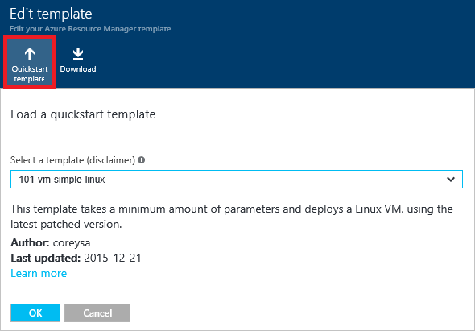
Deploy Templates – Portal, Quickstart

Slide 42
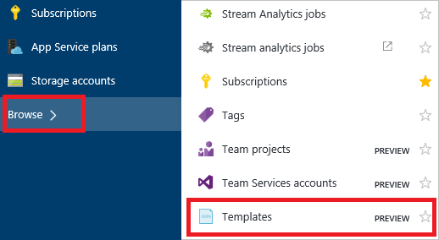
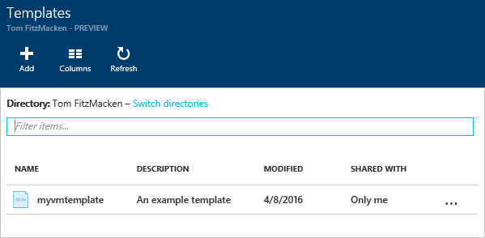
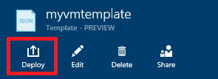
Deploy Templates – Portal, from Account

Slide 43
Deploy Templates – Portal
Create resource group
Deploy resources from Marketplace
Deploy resources from custom template
Deploy resources from a template saved to your account
Next Steps
https://docs.microsoft.com/en-us/azure/azure-resource-manager/resource-group-template-deploy-portal

Slide 44
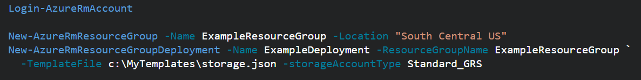
Deploy Templates - Powershell
Deploy a Template from a local json file
Deploy a Template from an external source:
Pass in a local parameter file:
Pass in an external parameter file

Slide 45
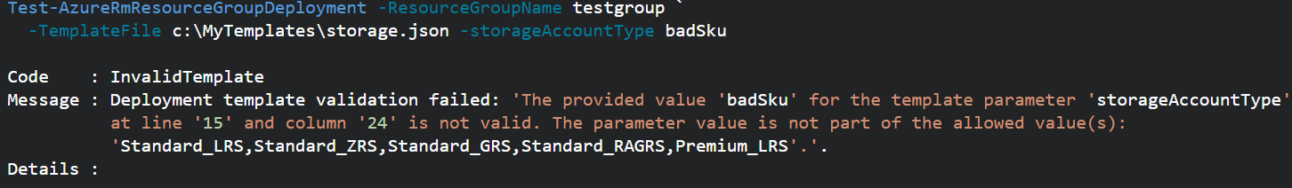
Deploy Templates - PowerShell
You can pass in parameters inline and with a local parameter file.
You CANNOT pass in parameters inline and with an external parameter file.
You can TEST a deployment before running it.
Template Deployments have 2 modes: INCREMENTAL or COMPLETE
Both modes deploy resources defined in Template.
Complete Deployment DELETES resources in group not defined in Template
Incremental does not DELETE resources not defined in Template
Use “-Mode” argument to set Mode.
https://docs.microsoft.com/en-us/azure/azure-resource-manager/resource-group-template-deploy

Slide 46
Deploy resources with Resource Manager templates and Azure PowerShell
Deploy a template from your local machine
Deploy a template from an external source
Parameter files
Test a template deployment
Incremental and complete deployments
Sample template
Next steps
https://docs.microsoft.com/en-us/azure/azure-resource-manager/resource-group-template-deploy

Slide 47
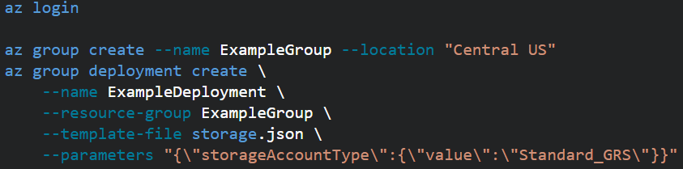

Deploy Templates – CLI (similar to PowerShell)
Local template file deploy:
External template file deploy, use --template-uri
To use a local parameter file, use @file.path with the --parameters argument.
External parameter files aren’t supported.
You can validate the template deployment. Use “az group deployment validate” and same arguments
Switch between Complete and Incremental mode, use --mode argument.
(You can now get the CLI directly in the Azure Portal! This is makes it super easy to use. Go to the portal and click this button in the top right nav bar: )
https://docs.microsoft.com/en-us/azure/azure-resource-manager/resource-group-template-deploy-cli

Slide 48
Regional Availability

Slide 49
Regional Availability - Regions
An Azure Region is a geographic region that contains a collection of data centers.
It’s more than one building.
There are over 30 Azure regions: https://azure.microsoft.com/en-us/regions/
Special / Sovereign Regions:
US Gov Virginia/Iowa
China East, China North
Germany Central, Gemany Northeast
Region Pairs
In same geography (such as US, Europe or Asia)
Replicated resources are replicated across pairs
In broad geographic outage, one region in the pair is prioritized
Data resides in the same geography as its pair (except Brazil South)
Pairs: https://docs.microsoft.com/en-us/azure/best-practices-availability-paired-regions#what-are-paired-regions
Azure Storage GRS and RA-GRS replicates data from one region to its pair.

Slide 50
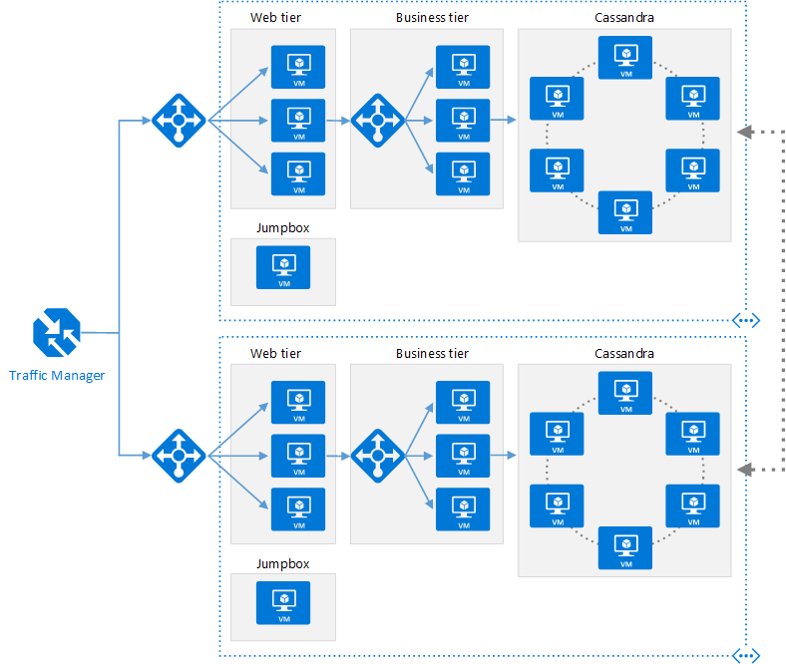
Regional Availability - Design
Primary/Secondary Region for Higher Availability
Traffic Manager routes requests
The same ARM template can be deployed, with minor parameter changes for VNET IP address space, and Resource locations.

Slide 51
Regional Availability - Design
Configurations
Active/passive with hot standby (rec)
Active/passive with cold standby
Active/active
Use Regional Pairing
In broad outage, one region from pair is prioritized
Traffic Manager
routing = priority,
health probe = write a custom service that reports accurately
Read Reference Architecture Here.
https://docs.microsoft.com/en-us/azure/architecture/reference-architectures/virtual-machines-linux/multi-region-application

Slide 52
High Availability
Availability within a region vs. Regional Availability
Azure Storage makes 3 copies of data within a region (including VM disks)
Use Availability Sets
Design loosely coupled service with asynchronous communication. Use Azure Storage queues or Azure Sevice Bus for queue-centric workflow.
Fault Detection and Retry Logic within your application
Circuit Breaker Pattern
Immutable Infrastructure, Infrastructure as Code
https://docs.microsoft.com/en-us/azure/architecture/resiliency/high-availability-azure-applications
https://docs.microsoft.com/en-us/azure/architecture/resiliency/index#designing-for-resiliency

Slide 53
Containers

Slide 54
Containers and Azure
Feature | VMs | Containers
"Default" security support | to a greater degree | to a slightly lesser degree
Memory on disk required | Complete OS plus apps | App requirements only
Time taken to start up | Substantially Longer: Boot of OS plus app loading | Substantially shorter: Only apps need to start because kernel is already running
Portability | Portable With Proper Preparation | Portable within image format; typically smaller
Image Automation | Varies widely depending on OS and apps | Docker registry; others
VMs vs. Containers
Containers offer greater density
Less wasted footprint
Containers are for both Windows and Linux
Azure Support for Containers
Install Docker on Azure VMs
Create a Docker Host from the Azure Marketplace
Azure Container Service
Create with Azure Portal or CLI
Supports Popular Orchestration engines: DC/OS, Docker Swarm, Kubernetes
https://docs.microsoft.com/en-us/azure/virtual-machines/linux/containers
https://docs.microsoft.com/en-us/azure/container-service/container-service-intro

Slide 55
I have an application that processes images locally before saving them to permanent storage. I need some disk space to temporarily store these files. What is the most cost effective option?
Azure File Storage
Azure Data Disk
Azure Blob Storage
Azure VM's Temporary Disk

Slide 56
I have an application that processes images locally before saving them to permanent storage. I need some disk space to temporarily store these files. What is the most cost effective option?
Azure File Storage
Azure Data Disk
Azure Blob Storage
Azure VM's Temporary Disk

Slide 57
I have an application that requires a consist and guaranteed amount of IOPS and throughput for accessing data on disks. What is the most cost effective option?
Azure File Storage
Azure Standard Storage Disks
Azure Premium Storage Disks
Standard Managed Disks

Slide 58
I have an application that requires a consist and guaranteed amount of IOPS and throughput for accessing data on disks. What is the most cost effective option?
Azure File Storage
Azure Standard Storage Disks
Azure Premium Storage Disks
Standard Managed Disks

Slide 59
My VM needs an "F" drive with at least 2TB of space. Which of the following do I need to consider when designing my VM?
Azure File Storage
Azure Standard Storage Disks
Azure Premium Storage Disks
Standard Managed Disks

Slide 60
My VM needs an "F" drive with at least 2TB of space. Which of the following do I need to consider when designing my VM?
Azure File Storage
Azure Standard Storage Disks
Azure Premium Storage Disks
Standard Managed Disks

Slide 61
I need to create a VM with one data disk. I must be able to export the disk to a VHD file and host in a storage account and I need to take snapshots of the disk. Which of the following can I use?
Standard Unmanaged Disk
Premium Unmanaged Disk
Standard Managed Disk
Premium Managed Disk

Slide 62
I need to create a VM with one data disk. I must be able to export the disk to a VHD file and host in a storage account and I need to take snapshots of the disk. Which of the following can I use?
Standard Unmanaged Disk
Premium Unmanaged Disk
Standard Managed Disk
Premium Managed Disk

Slide 63
I've created a VM with a database installed and configured. It uses 2 Data Disks. I need to be able to deploy this VM in multiple scenarios. What is the simplest way to redeploy this VM multiple times?
Take a snapshot
Capture an image
Build an ARM Template
Export to a VHD file

Slide 64
I've created a VM with a database installed and configured. It uses 2 Data Disks. I need to be able to deploy this VM in multiple scenarios. What is the simplest way to redeploy this VM multiple times?
Take a snapshot
Capture an image
Build an ARM Template
Export to a VHD file

Slide 65
Every VM in an availability set gets:
One Fault Domain, One Update Domain
Two Fault Domains, One Update Domain
One Fault Domain, Two Update Domains
Two Fault Domains, Two Update Domains

Slide 66
Every VM in an availability set gets:
One Fault Domain, One Update Domain
Two Fault Domains, One Update Domain
One Fault Domain, Two Update Domains
Two Fault Domains, Two Update Domains

Slide 67
To build a highly available VM solution, I need at least 2 VMs in
The Same Azure Region
The Same Resource Group
The Same Vnet
The Same Availability Set
The Same Load Balancer Backend Pool

Slide 68
To build a highly available VM solution, I need at least 2 VMs in
The Same Azure Region
The Same Resource Group
The Same Vnet
The Same Availability Set
The Same Load Balancer Backend Pool

Slide 69
To deploy an externally available Azure ARM Template, but keep it secure, I can:
Host it in a public Azure storage container
Host it in our on-premises corporate network
Host in a private Azure storage container and use a SAS token
Host it in a private Github repository

Slide 70
To deploy an externally available Azure ARM Template, but keep it secure, I can:
Host it in a public Azure storage container
Host it in our on-premises corporate network
Host in a private Azure storage container and use a SAS token
Host it in a private Github repository

Slide 71
My ARM Template needs to manipulate strings to name and reference the resources correctly. The easiest way to do this is:
Add a custom script extension that can execute powershell or Bash
Generate the correct strings externally and pass them in as parameters
Use complex objects as ARM Template variables
Use ARM Template functions.

Slide 72
My ARM Template needs to manipulate strings to name and reference the resources correctly. The easiest way to do this is:
Add a custom script extension that can execute powershell or Bash
Generate the correct strings externally and pass them in as parameters
Use complex objects as ARM Template variables
Use ARM Template functions.

Slide 73
My solution needs to be always available, even if an entire Azure region suffers an outage. What is my best option from among the following?
Deploy a primary solution to an Azure region nearest my customer, and a secondary solution in the same region as well
Deploy a primary solution to an Azure region nearest my customer, and a secondary solution geographically as far from my primary region as possible
Deploy a primary solution to an Azure region nearest my customer, and a secondary solution in the primary's paired Azure region
Deploy a primary solution to an Azure region nearest my customer, and a secondary solution in the closest geographical region

Slide 74
My solution needs to be always available, even if an entire Azure region suffers an outage. What is my best option from among the following?
Deploy a primary solution to an Azure region nearest my customer, and a secondary solution in the same region as well
Deploy a primary solution to an Azure region nearest my customer, and a secondary solution geographically as far from my primary region as possible
Deploy a primary solution to an Azure region nearest my customer, and a secondary solution in the primary's paired Azure region
Deploy a primary solution to an Azure region nearest my customer, and a secondary solution in the closest geographical region

Slide 75
Labs
https://github.com/michaelsrichter/70534ExamPrep

